Slide 1

Chaining Methods and Properties
By Min Thet Naing

Slide 2
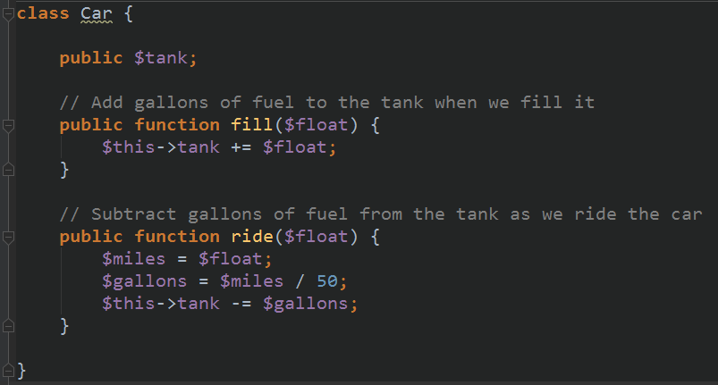

By Min Thet Naing

Slide 3
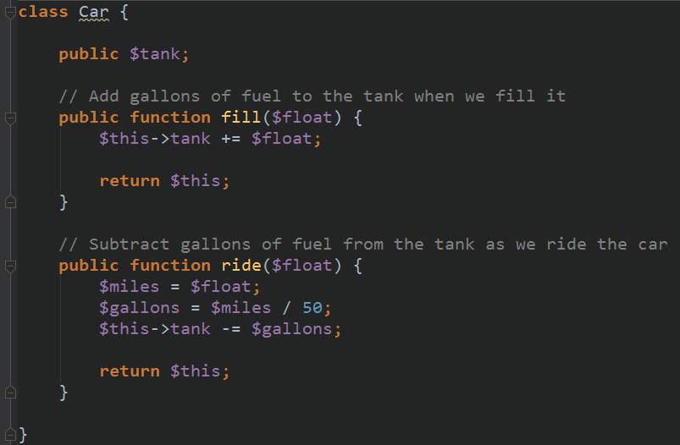
By Min Thet Naing

Slide 4
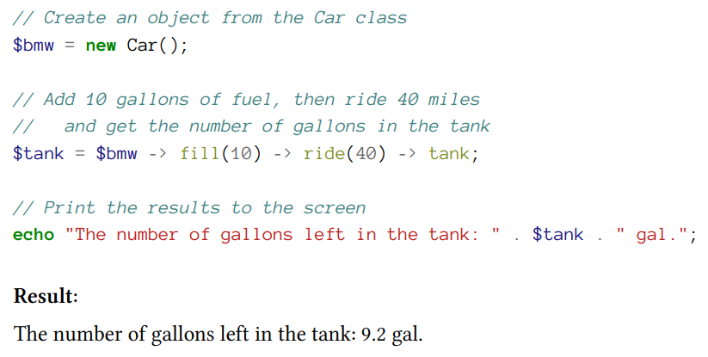
By Min Thet Naing

